Slide 1

METALS AND
NON-METALS
Introduction and physical properties of metals

Slide 2
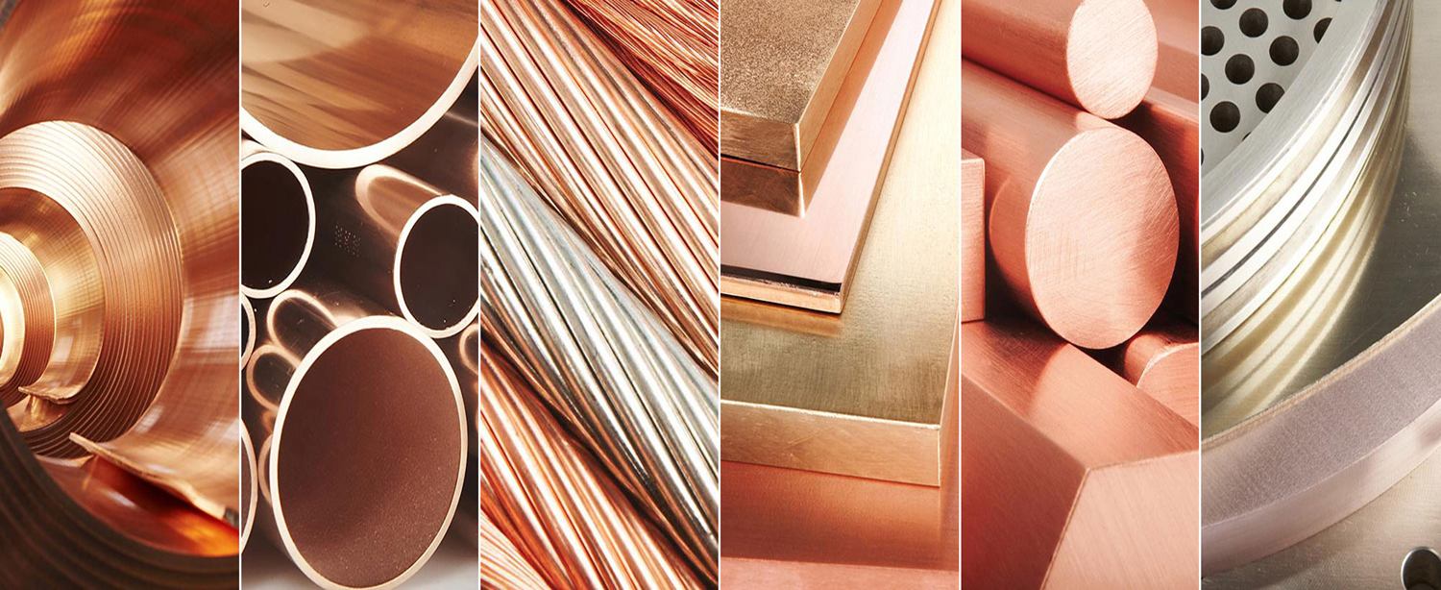
METALS AND
NON-METALS

Slide 3
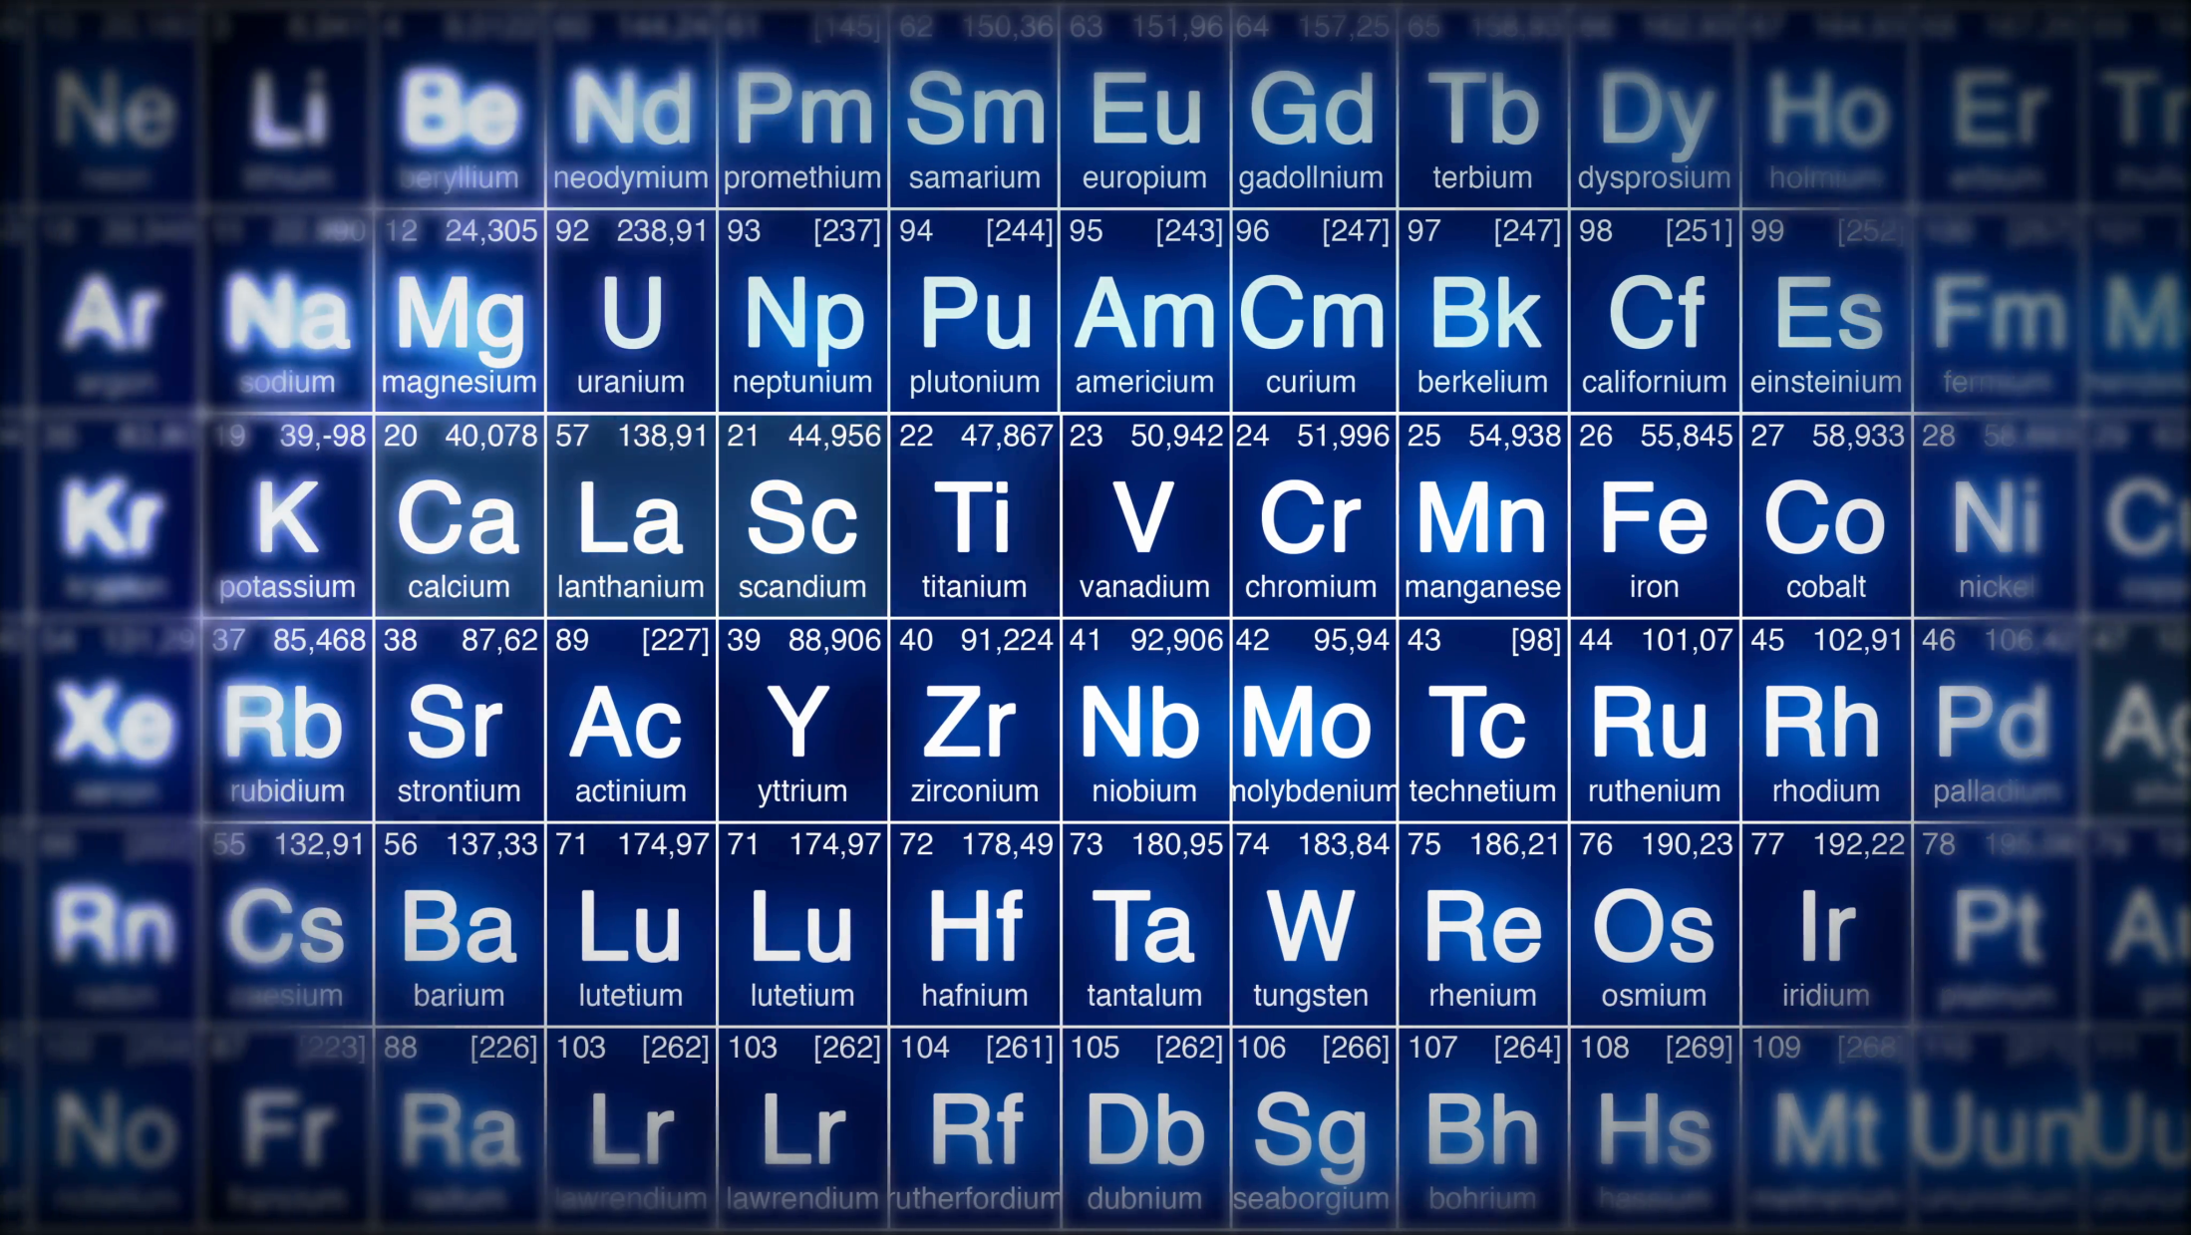
INTRODUCTION
There are 118 chemical elements known at present.

Slide 4

On the basis of their properties, all the elements
can be divided into two main groups.
Metals
Non-metals

Slide 5

Silver
z

Slide 6
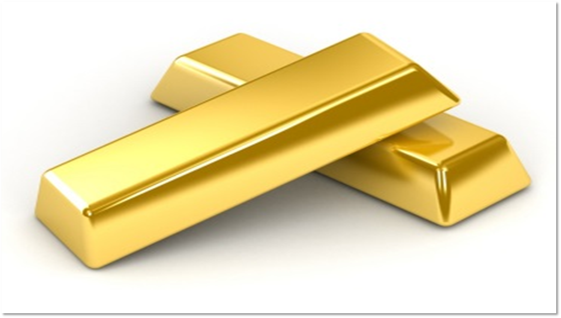
Gold
z

Slide 7
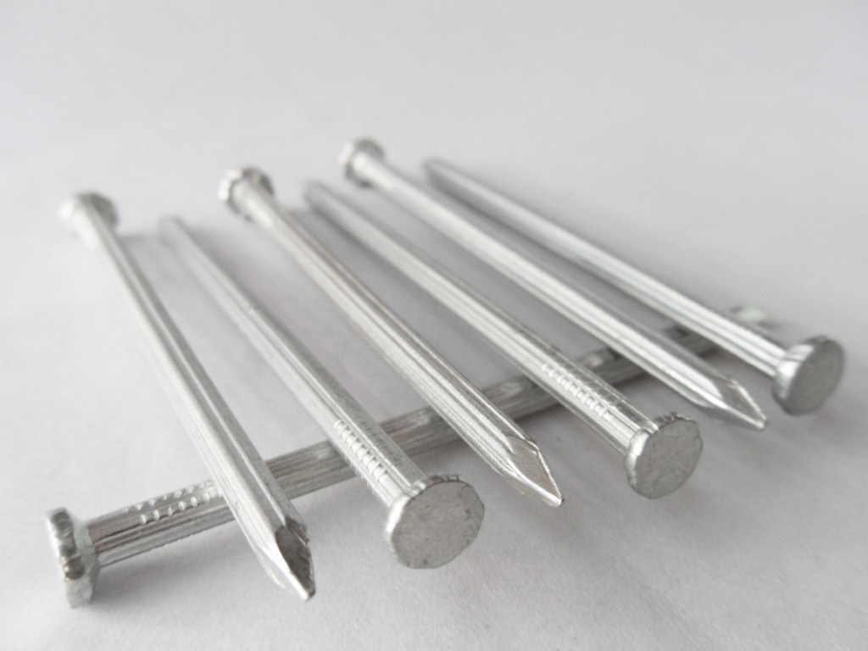
Iron nails

Slide 8
On the basis of their properties, all the elements
can be divided into two main groups.
Metals
Non-metals

Slide 9
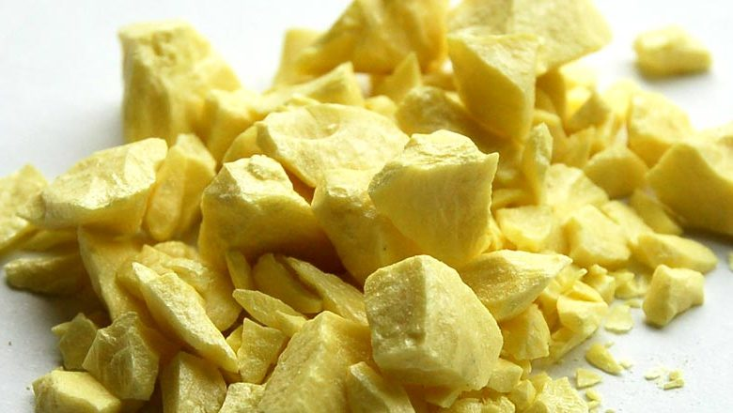
Sulphur

Slide 10
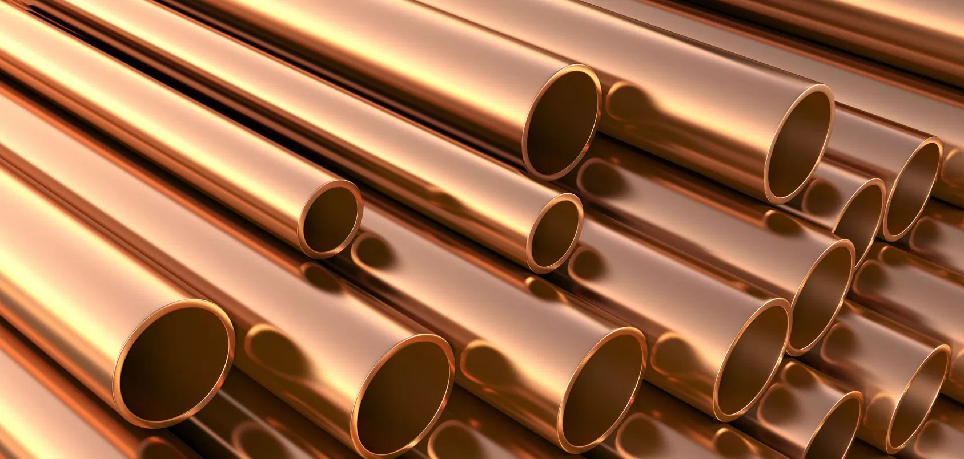
Copper

Slide 11
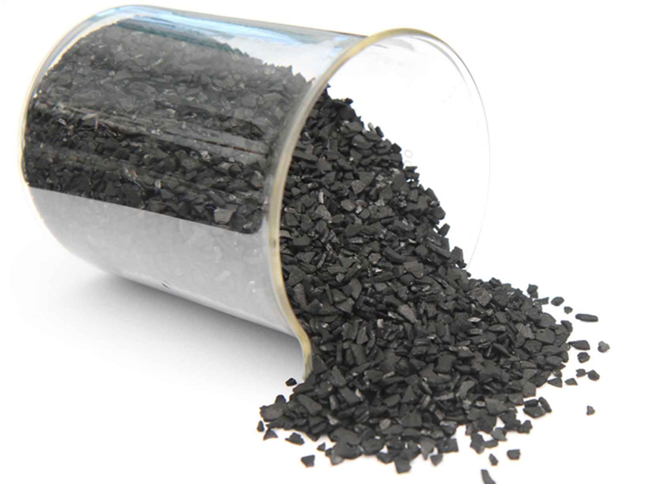
Carbon

Slide 12
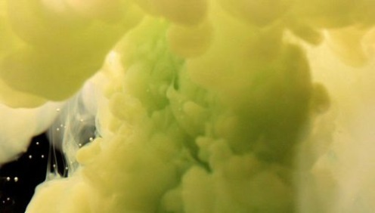
Chlorine gas

Slide 13



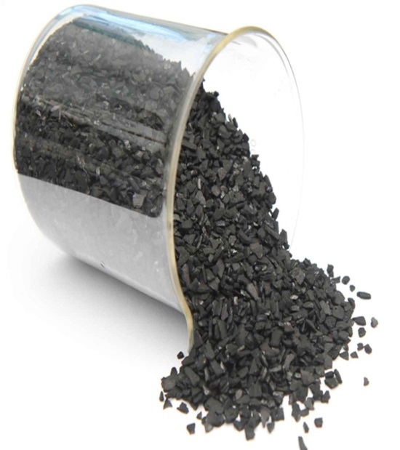
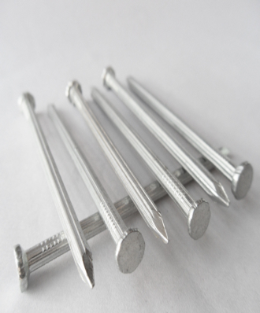
Both, metals as well as non-metals are used in our
daily life.

Slide 14
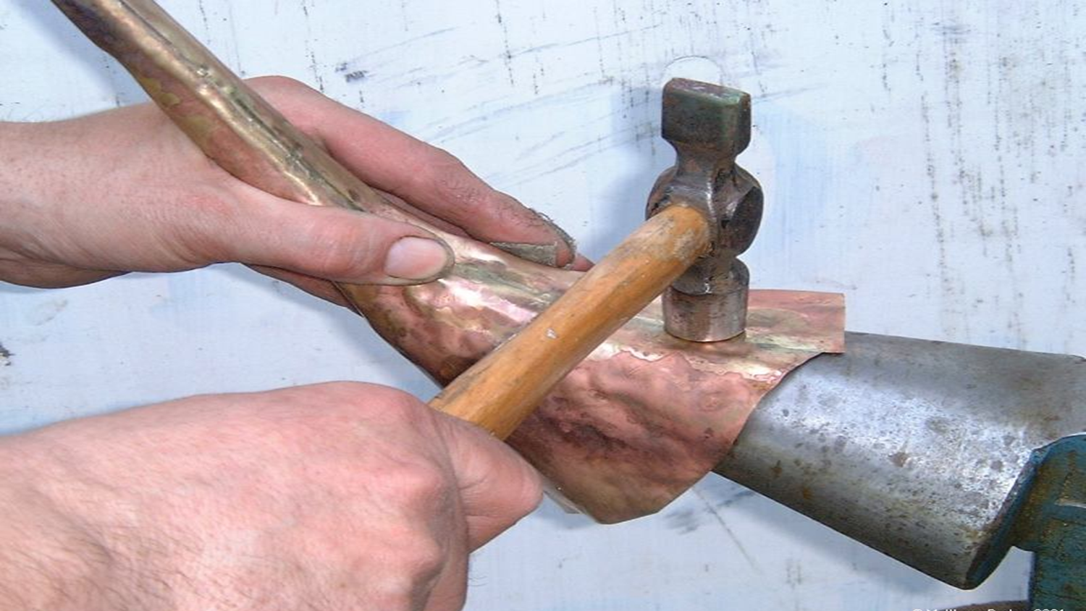
PHYSICAL PROPERTIES OF METALS
Metals are malleable,
i.e. metals can be beaten / hammered into thin sheets.

Slide 15
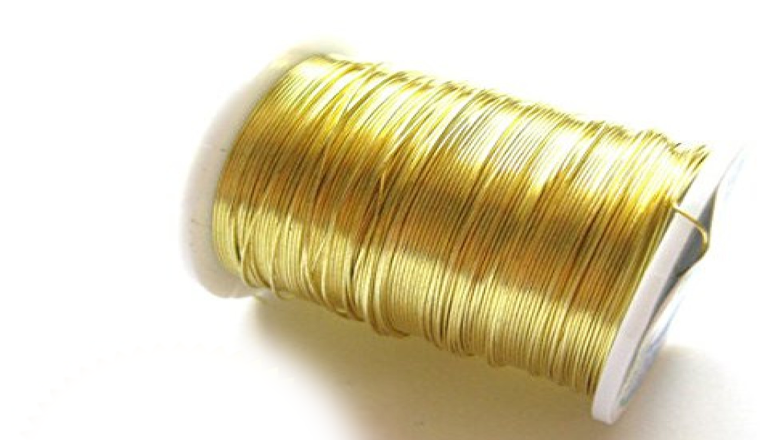
Metals are ductile,
i.e. metals can be drawn or stretched into thin wires.
About 1 g of gold can be drawn into a thin wire of
about 2 km long.
Gold is the most ductile metal.

Slide 16

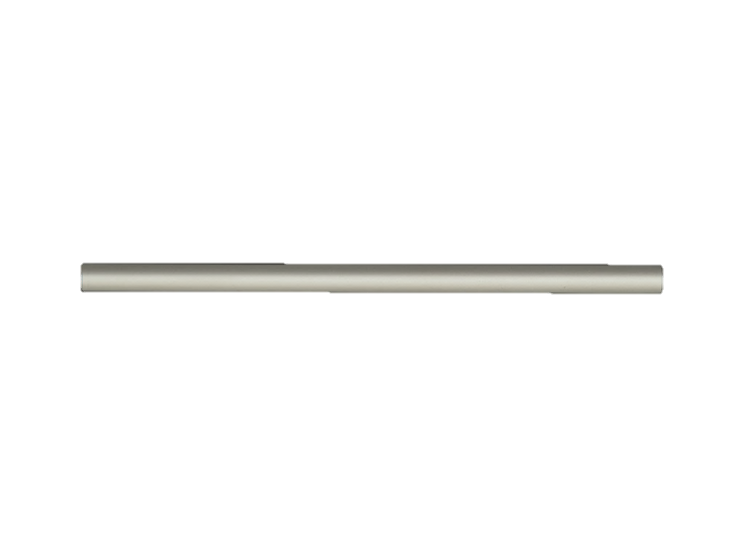

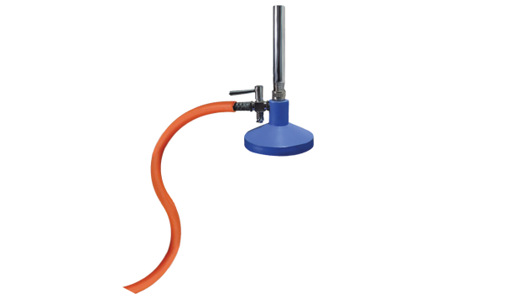
Metals are good conductors of heat.
Aluminium rod
Silver is the best conductor
of heat followed by copper.

Slide 17
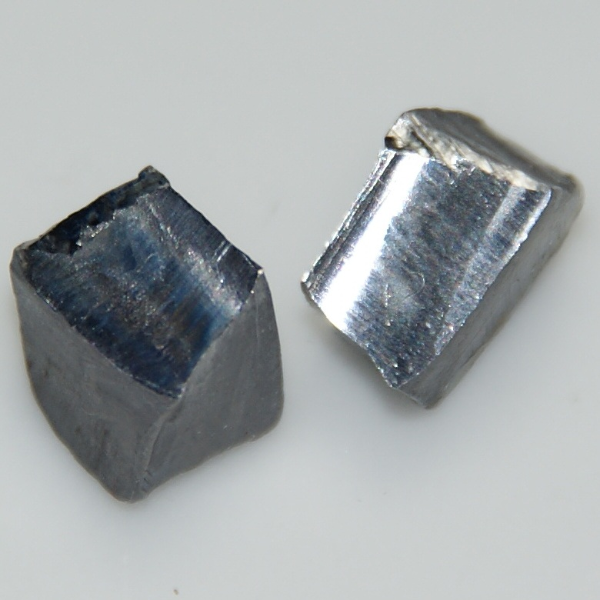
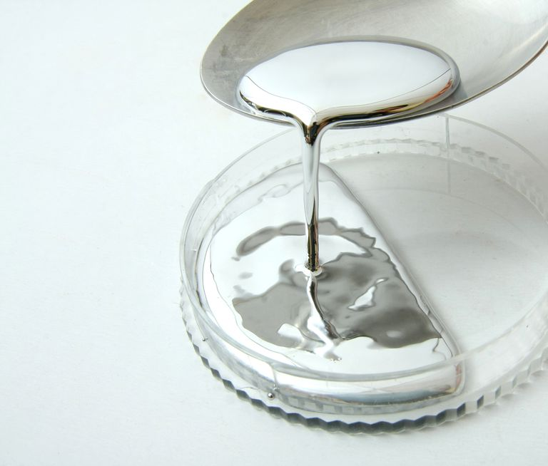
The poorest conductors of heat among
the metals are Lead and Mercury.

Slide 18
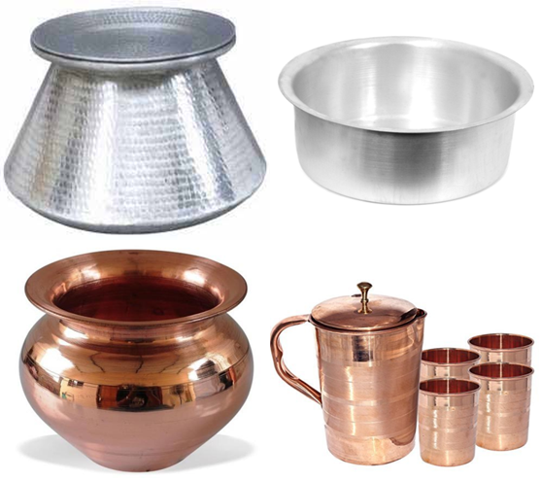
The cooking utensils and water boilers,
are usually made of copper or aluminium.

Slide 19
METALS AND
NON-METALS
Physical properties of metals

Slide 20

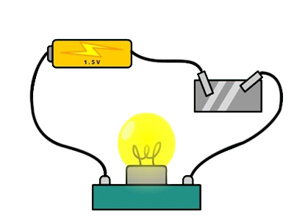



PHYSICAL PROPERTIES OF METALS
Metals are good conductors of electricity.
Paper
Aluminium foil
Bulb does not glow
Bulb glows
Electric wires are made up of copper and
aluminium.
Silver is the best conductor of electricity
followed by copper.

Slide 21
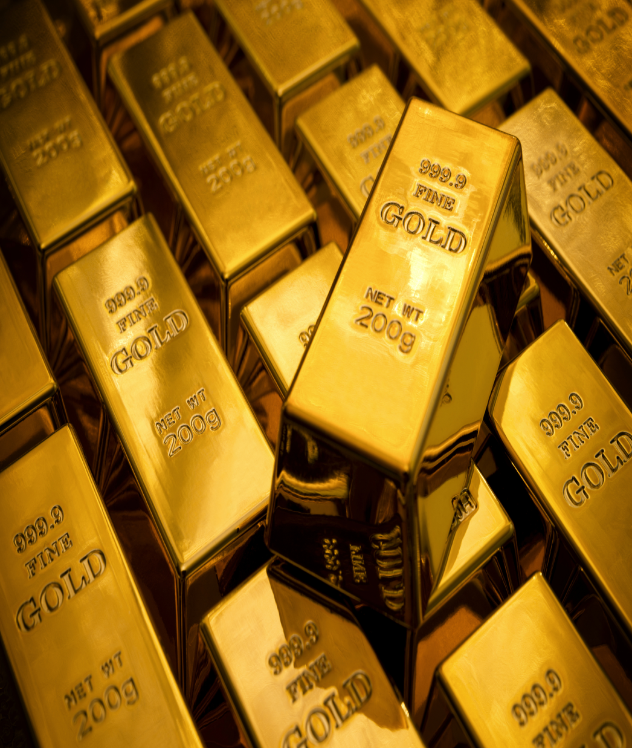
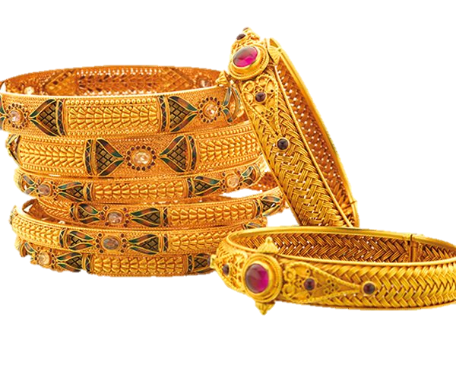
Metals are lustrous (or shiny), and can be polished.

Slide 22
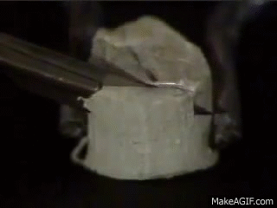
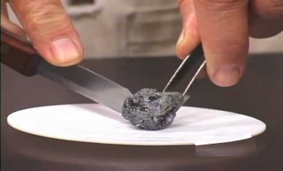
Metals are generally hard (except sodium and potassium).
Sodium
Potassium
Sodium and potassium are soft metals can be
easily cut with a knife.

Slide 23

Metals are hard.

Slide 24
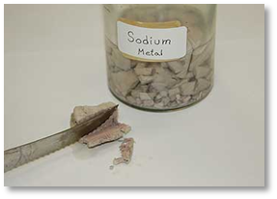
Except sodium, and potassium

Slide 25
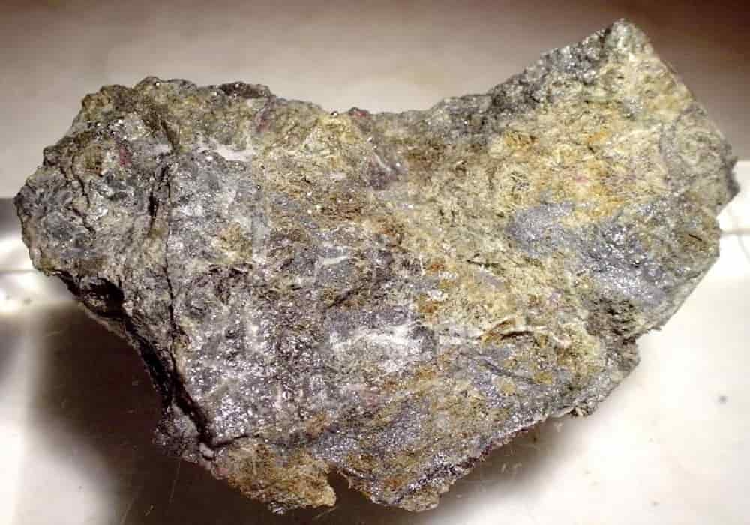
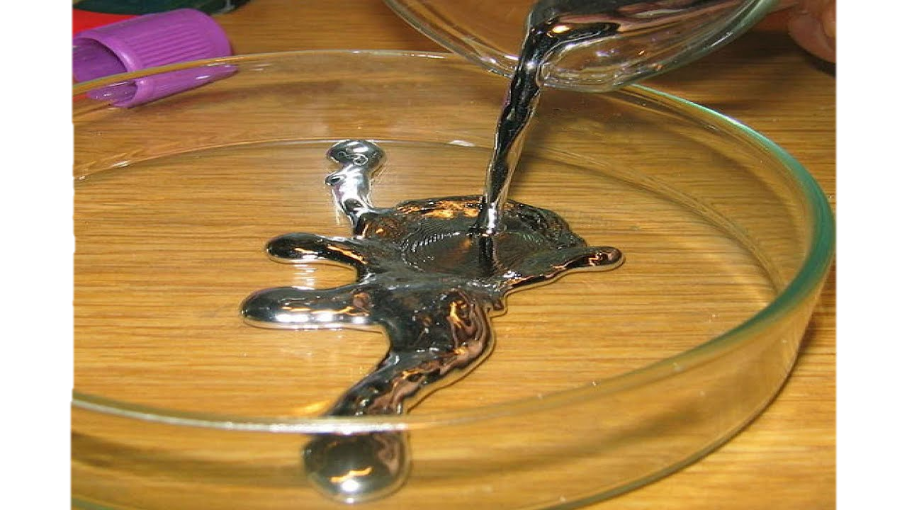
Metals are solids at room temperature
(except mercury which is a liquid metal).

Slide 26
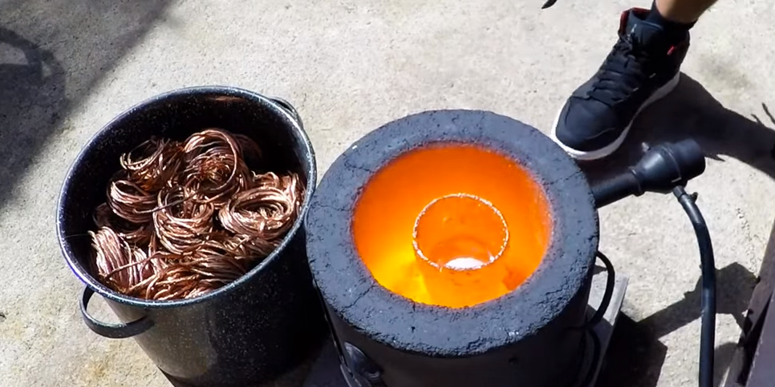
Metals have high melting points and

Slide 27
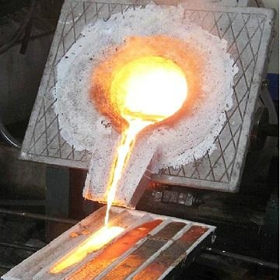
Metals have high melting points and
boiling points.
Except sodium and potassium which have low
melting and boiling points.

Slide 28
Metals have high densities.
Except sodium, and potassium metals which
have low densities.

Slide 29
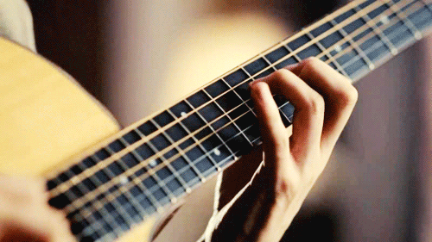
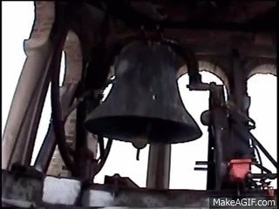
Metals are sonorous.
i.e. metals make sound when struck with an
object.

Slide 30
METALS AND
NON-METALS
Physical properties of non-metals

Slide 31
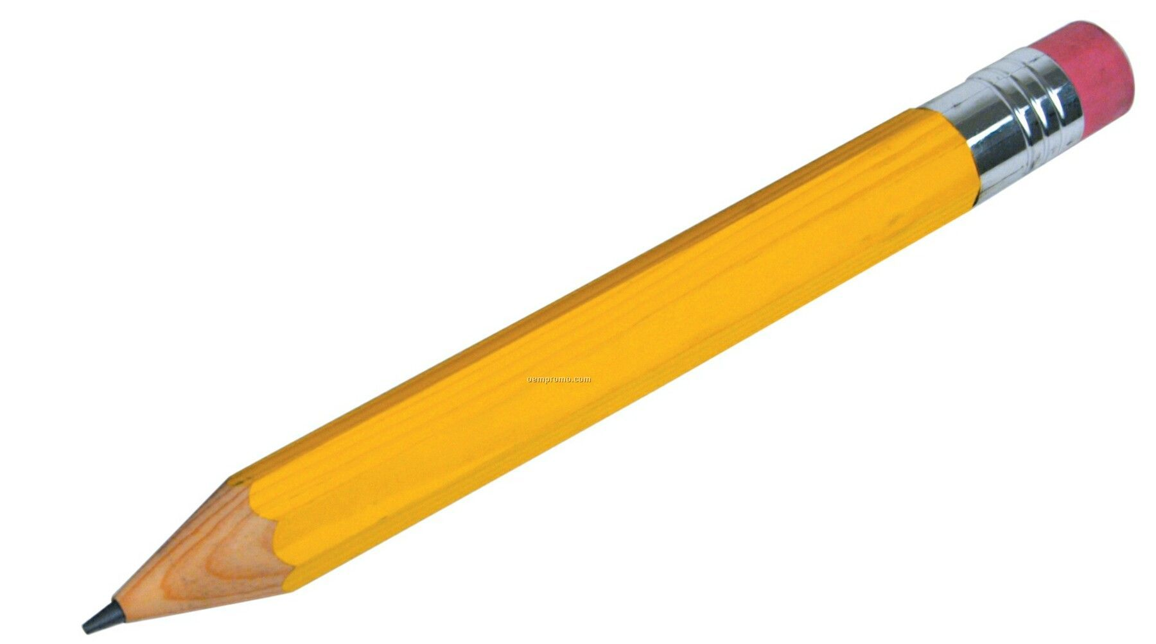
PHYSICAL PROPERTIES OF NON-METALS
Non-metals are neither malleable nor ductile.

Slide 32

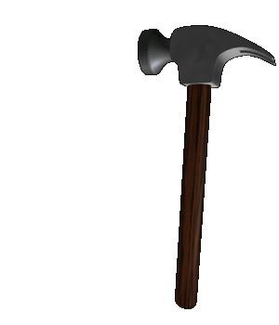
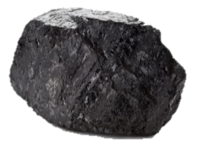
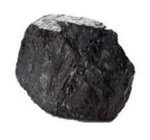
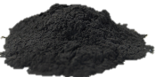
Non-metals are brittle (break easily).

Slide 33

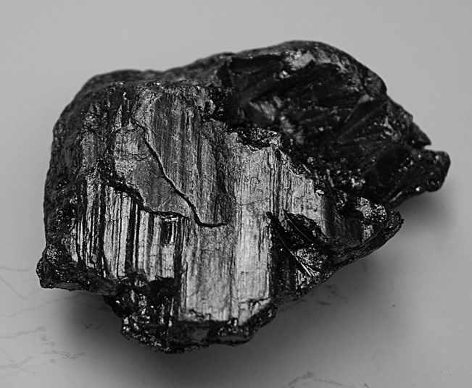
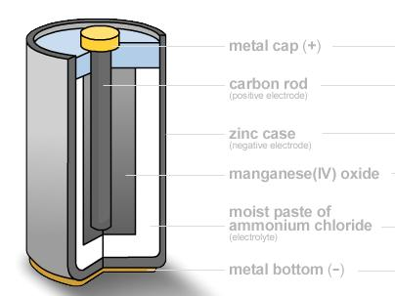
Non-metals do not conduct heat and electricity.
Sulphur
Graphite
Good conductor
Graphite
Except carbon in the form of graphite.

Slide 34
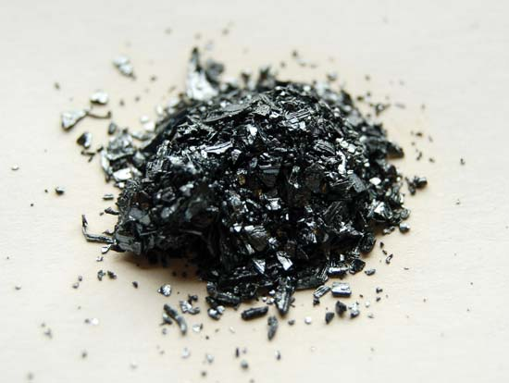
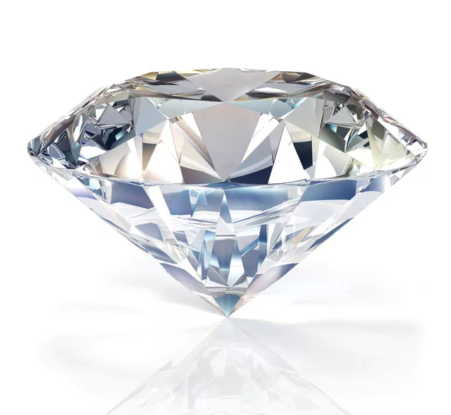
Non-metals are non lustrous, they are dull.
Carbon
Diamond

Slide 35
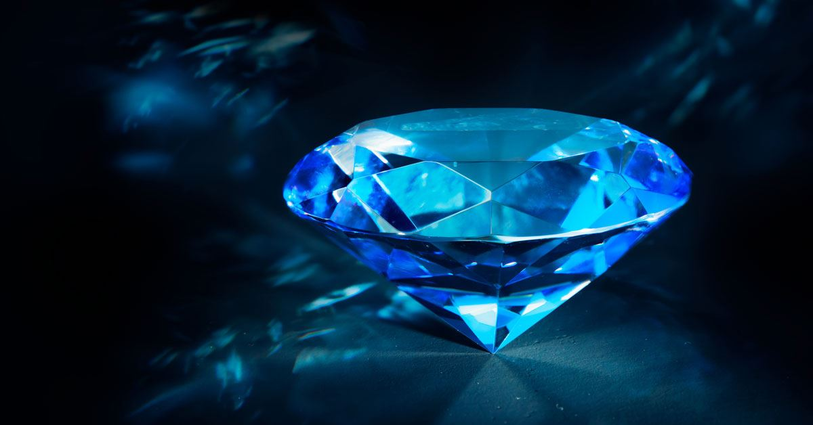
Non-metals are generally soft.
Except carbon in the form of diamond is very hard.

Slide 36
Non-metals are not strong. They are easily broken.
Except carbon in the form of diamond.

Slide 37
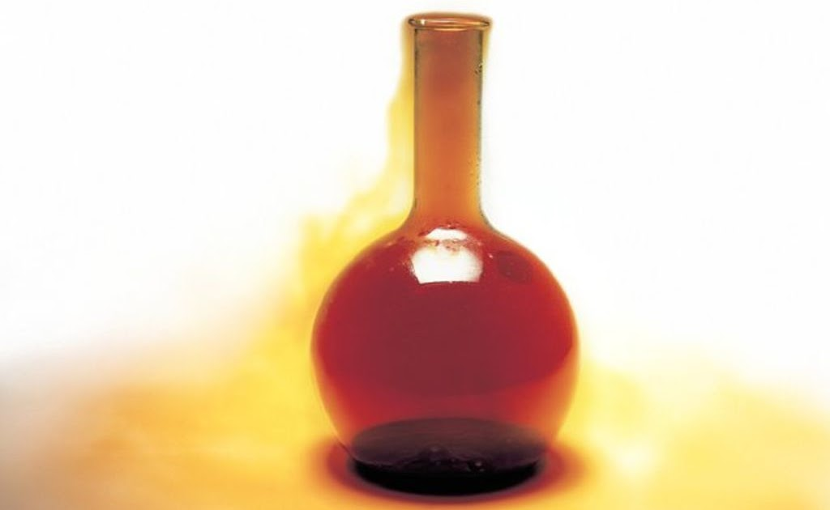

Non-metals may be solid, liquid or gases at the room temperature.
Sulphur in solid state
Bromine in liquid state
Chlorine in gaseous state

Slide 38
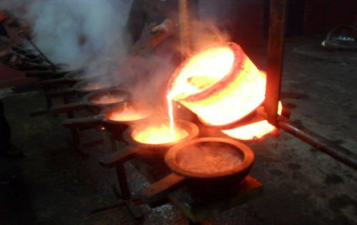
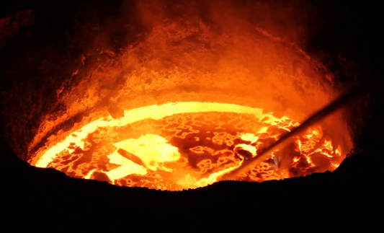
Non-metals have comparatively low melting points
and boiling points.
Except diamond which is a non-metal having high
melting point and boiling point.

Slide 39
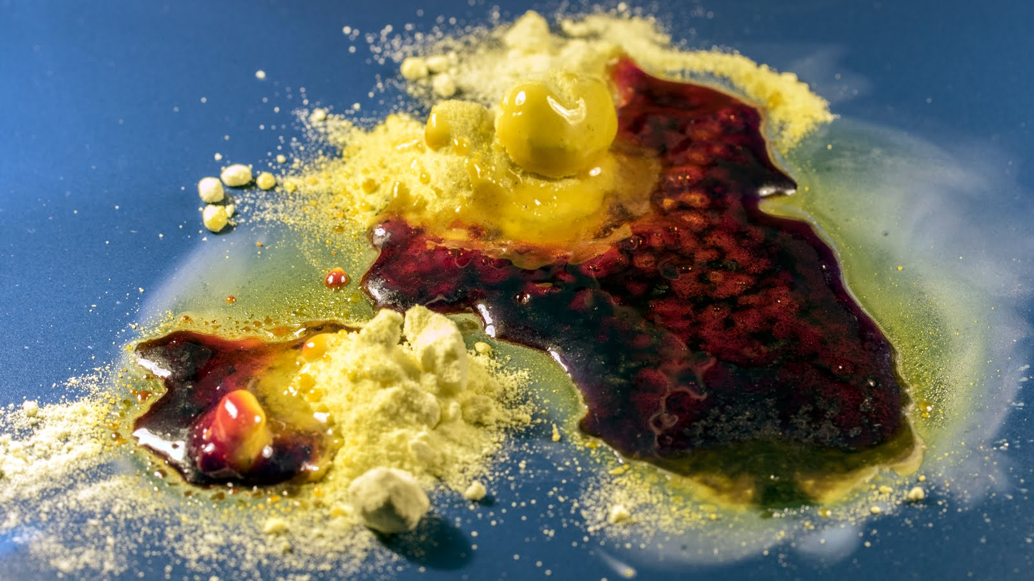
For example melting point of sulphur
is 115°C which is quite low.

Slide 40
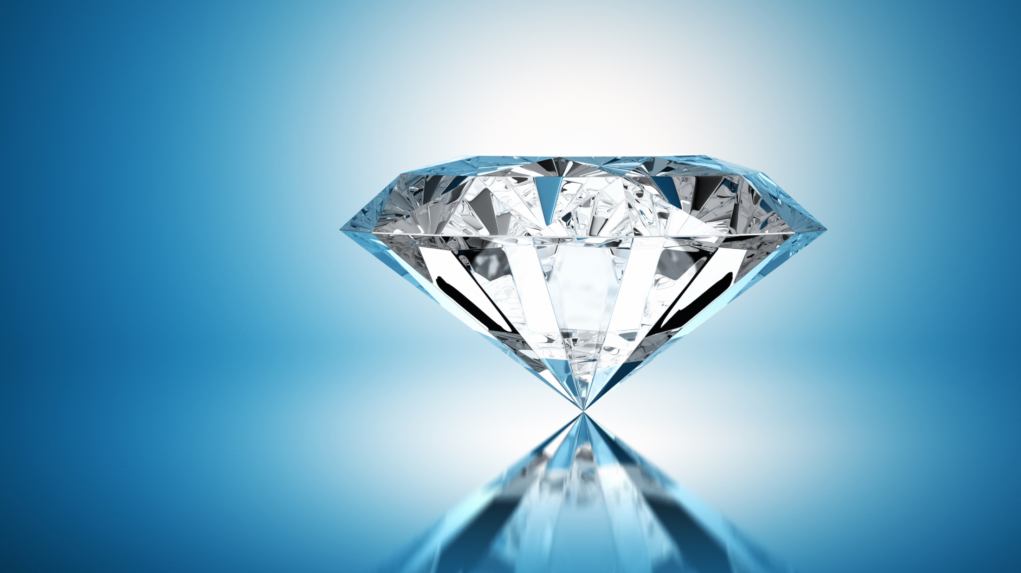
Melting point of diamond is more than 3500°C which is very high.
Non-metals have low densities.
Non-metals are non-sonorous.

Slide 41
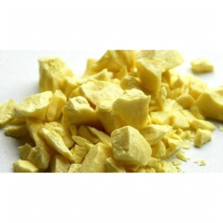
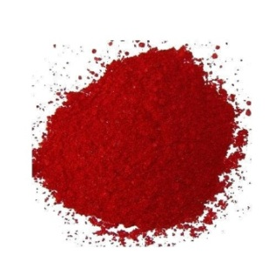
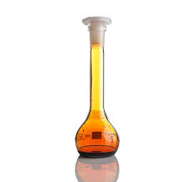
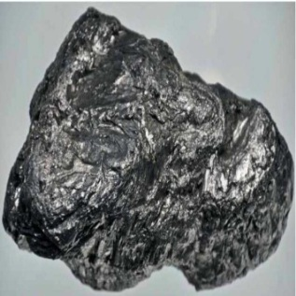
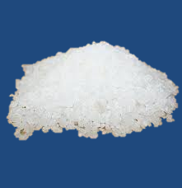
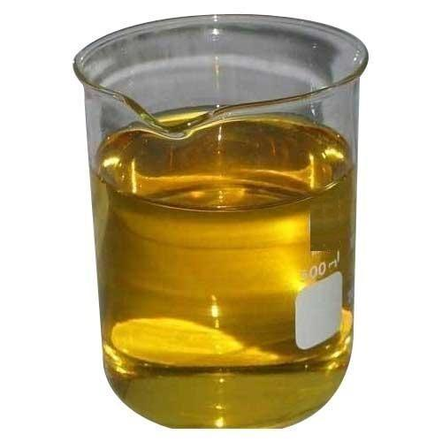
Non-metals have different colours.
Sulphur
Chlorine
Red phosphorus
Non-metals have different colours.
Graphite
Bromine
White phosphorus

Slide 42
METALS AND
NON-METALS
Chemical properties of metals
Reactivity Series of metals

Slide 43

CHEMICAL PROPERTIES
OF METALS

Slide 44


REACTIVITY SERIES
K is most reactive
K
Potassium
Na
Sodium
I
N
C
R
E
A
S
E
S
D
E
C
R
E
A
S
E
S
Ca
Calcium
Mg
Magnesium
Al
Aluminium
Zn
Zinc
Fe
Iron
Pb
Lead
[H]
[Hydrogen]
The arrangement of metals in the decreasing
order of their reactivity in the form of series is
called the reactivity series of the metal.
Cu
Copper
As we move up, reactivity increases
As we move down, reactivity decreases
Hg
Mercury
Ag
Silver
Gold is least reactive
Au
Gold

Slide 45
METALS AND
NON-METALS
Chemical properties of metals
Reaction of metals with oxygen

Slide 46

1.
REACTION WITH OXYGEN

Slide 47
Na and K being most reactive, react with oxygen at
room temperature to form oxides.
Almost all metals react with oxygen to form metal
oxide but reactivity differs for different metals.
METAL
+
OXYGEN
METAL OXIDE
2
2
4
K
+
O₂
K₂O
Potassium
Oxygen
Potassium oxide
2
+
4
Na
O₂
2
Na₂O
Sodium
Oxygen
Sodium oxide

Slide 48
Magnesium does not react with oxygen at room
temperature but on heating, magnesium burns in air
with intense light and heat to form Magnesium oxide.
Mg
+
O₂
∆
2
MgO
2
Magnesium
Oxygen
Magnesium oxide

Slide 49
Zinc burns in air only on strong heating to form zinc
oxide.
2
∆
Zn
+
O₂
2
ZnO
On strong heating
Zinc
Oxygen
Zinc oxide

Slide 50





∆
Iron does not burn even on strong heating.
But iron filings burn vigorously when
sprinkled in the flame of the burner.
3
Fe
+
2
O₂
Fe₃O₄
Iron
Oxygen
Iron oxide
Iron (Fe) filings on strong heating form
iron oxide.
Ferric oxide (FeO)
Ferrous oxide (FeO)
Iron oxide
Iron
Burner

Slide 51

∆
2
Cu
+
O₂
2
CuO
Copper is least reactive.
It does not burn, but on heating, the hot metal is coated
with a black coloured layer of copper oxide.
Copper
Oxygen
Copper Oxide
4
∆
Al
3
O₂
2
+
Al₂O₃
Aluminium
Oxygen
Aluminium Oxide
Cu

Slide 52
K
Room
temperature
Na
Ca
Heat
Mg
Al
Strong Heating
Zn
Fe
Heat Filings
Pb
Cu
Strong
Heating
Hg
Ag
Au

Slide 53
METALS AND
NON-METALS
Chemical properties of metals
Reaction of water with metal oxides
Nature of oxides

Slide 54
REACTION WITH
WATER

Slide 55
2.
REACTION WITH WATER

Slide 56
Most metal oxides are insoluble in water but some of these
dissolve in water to form alkalis.
Metal
+
Water
Metal Hydroxide
+ H₂
(Cold)
Metal
+
Water
Metal Hydroxide
+ H₂
(Hot)
Metal
+
Water
Metal oxide
+ H₂
(Steam)

Slide 57
K and Na oxides dissolve in water to produce alkalis as follows.
K₂O
+
H₂O
KOH
2
Potassium oxide
Water
Potassium hydroxide
2
Na₂O
+
H₂O
NaOH
Sodium oxide
Water
Sodium hydroxide

Slide 58
NATURE OF OXIDES
ACID
+
BASE
SALT
+
WATER
Behaves like Base
?
Metal oxide
+
Acid
Salt
+
Water
Metal oxides are BASIC in nature.
Exception:- Al₂O₃ , ZnO

Slide 59
AMPHOTERIC OXIDES
Non-metal oxides are ACIDIC in nature.
Behaves like Acid
?
Non Metal oxide
+
Base
Salt
+
Water
In presence of base Al₂O₃ is acting like an acid
Acid
Base
Salt
Water
?
Al₂O_{3(s)}
+
2
2
+
NaOH_{(aq)}
NaAlO_{2(aq)}
H₂O
Aluminum oxide
Sodium
hydroxide
Sodium
aluminate
Water

Slide 60
Oxides which react with acids as well as bases to
produce salts and water are known as
AMPHOTERIC OXIDES. e.g. Al₂O₃ , ZnO
In presence of base Al₂O₃ is acting like an Base
?
Base
Acid
Salt
Water
6
2
H₂O
Al₂O_{3(s)}
+
HCl_{(aq)}
AlCl_{3(aq)}
+
3
Aluminium
oxide
Hydrochloric
acid
Aluminium
chloride
Water

Slide 61
METALS AND
NON-METALS
Chemical properties of metals
Reaction with water
(High reactive metals)

Slide 62
2.
REACTION WITH WATER

Slide 63

Potassium and Sodium are stored in Kerosene because they react with both Water as well as Oxygen in the Air at normal
room temperature.
Na and K react with water to evolve hydrogen gas which
immediately catches fire producing a lot of heat.
Metals like K and Na react vigorously with cold water.
Metal
+
Water
Metal
Hydroxide
+
H₂
(Cold)
2
K
+
H₂O
2
2
KOH
+
H₂
+
Heat
Potassium
Water
Potassium hydroxide
Hydrogen
2
Na
+
H₂O
2
2
NaOH
+
H₂
+
Heat
Sodium
Water
Sodium hydroxide
Hydrogen

Slide 64
METALS AND
NON-METALS
Chemical properties of metals
Reaction with water
(Medium reactive metals)

Slide 65
2.
REACTION WITH WATER

Slide 66





Calcium starts floating because the bubbles
of hydrogen gas formed stick to the surface
of the metal.
Calcium reacts with water less vigorously, hence the heat evolved is not sufficient for hydrogen to catch fire.
+
Ca
+
2
H₂O
Ca (OH)₂
H₂
Calcium
Water
Calcium hydroxide
Hydrogen
Test tube stand

Slide 67
Metal
+
Water
Metal Hydroxide
+
H₂
(Hot)
Mg
+
H₂O
Mg(OH)₂
H₂
2
+
Magnesium
(Hot)
Magnesium hydroxide
Hydrogen

Slide 68








3
4
4
Fe_{(s)}
2
+
3
H₂O_{(g)}
Fe₃O_{4(s)}
3
Al_{(s)}
+
H₂O_{(g)}
Al₂O_{3(s)}
H_{2(g)}
Metal
+
Water
Metal oxide
H₂
H_{2(g)}
+
+
+
Glass wool is an insulating material.
It is made of glass but has a texture of wool.
On heating, water from glass wool converts
into steam which in turn reacts with the metal.
For the metals that do not react with hot water, arrange the apparatus as shown in the figure and observe the reaction with steam.
Iron
(Steam)
Water
Iron oxides
Hydrogen
Aluminum
Water
Aluminium oxides
Hydrogen
Metal sample
(Al, Fe or Zn)
Glass wool
soaked in water
Delivery tube
Hydrogen
Test tube
Cork
Bunsen burner
Steam
Hydrogen
Stand
Water trough

Slide 69
METALS AND
NON-METALS
Chemical properties of metals
Reaction with water
(Low reactive metals)

Slide 70
2.
REACTION WITH WATER (Steam)

Slide 71
Metal
+
Water
Metal oxide
+
H₂
Metal
(Al/Zn/ Fe/Pb)
(Steam)
2
Al_{(s)}
+
H₂O_{(g)}
Al₂O_{3(s)}
3
3
+
H₂↑
Aluminium
Water
Aluminum oxide
Hydrogen
Zn_{(s)}
+
H₂O_{(g)}
ZnO_{(s)}
+
H₂↑
Zinc
Water
Zinc oxide
Hydrogen

Slide 72
3
Fe_{(s)}
+
4
H₂O_{(g)}
Fe₃O_{4(s)}
H_{2(g)}
+
4
Iron
Water
Iron oxide
Hydrogen
Pb_{(s)}
+
H₂O_{(g)}
PbO_{(s)}
+
H_{2(g)}
Lead
Water
Lead oxide
Hydrogen

Slide 73
K
Cold water
Na
Ca
Mg
Hot water
Al
Steam
Zn
Fe
Steam
Pb
(H)
Less reactive metals like Cu, Hg, Ag, Au will
not react with water as they cannot displace
Hydrogen from water.
Cu
Do not
react
with
water
Hg
Ag
Au

Slide 74
METALS AND
NON-METALS
Chemical properties of metals
Reaction with dilute Acids
(dil. HCl)

Slide 75
REACTION WITH
DILUTE ACIDS

Slide 76
3.
REACTION WITH DILUTE HYDROCHLORIC ACID

Slide 77




METAL
+
ACID
METAL SALT
+
H₂↑
Mg
+
2
Zn
+
HCl
MgCl₂
+
H₂↑
2
HCl
ZnCl₂
+
H₂↑
The vigour of the reaction of a metal with dilute acid depends on its chemical reactivity.
Hydrogen chloride
Magnesium
chloride
Magnesium
Hydrogen chloride
Zinc chloride
Hydrogen
Zinc
Hydrogen
Some metals react explosively (extremely rapid) with
dilute acids, some metals react rapidly, some metals react
only on heating whereas others do not react at all.
Al
+
2
HCl
2
2
6
AlCl₃
+
H₂↑
Fe
+
2
3
HCl
FeCl₂
+
H₂↑
Hydrogen chloride
Iron chloride
Aluminium
Hydrogen chloride
Aluminium chloride
Hydrogen
Iron
Hydrogen
H₂ gas
H₂ gas
H₂ gas
H₂ gas
HCl
HCl
HCl
HCl
Magnesium
Aluminium
Zinc
Iron
Magnesium
Aluminium
Zinc
Iron

Slide 78
METALS AND
NON-METALS
Chemical properties of metals
Reaction with dilute Acids
(dil. H₂SO₄)

Slide 79
REACTION WITH
DILUTE ACIDS

Slide 80
4.
REACTION WITH DILUTE SULPHURIC ACID

Slide 81
Copper does not react with dilute hydrochloric acid (or
dilute sulphuric acid) at all.
This shows that copper is even less reactive than iron.
Iron on reacting with sulphuric acid gives iron sulphate and hydrogen gas
METAL
+
ACID
METAL SALT
+
H₂
Fe
+
H₂SO₄
FeSO₄
+
H₂
Iron
Sulphuric acid
Iron Sulphate
Hydrogen
Zn
+
H₂SO₄
ZnSO₄
+
H₂
Zinc
Sulphuric acid
Zinc Sulphate
Hydrogen
Mg
+
H₂SO₄
MgSO₄
+
H₂
Magnesium
Sulphuric acid
Magnesium Sulphate
Hydrogen

Slide 82
METALS AND
NON-METALS
Chemical properties of metals
Reaction with dilute Acids
(dil. HNO₃)
Aquaregia

Slide 83
REACTION WITH
DILUTE ACIDS

Slide 84
5.
REACTION WITH NITRIC ACID

Slide 85
When metal reacts with HNO₃, H₂ gas is not evolved.
HNO₃ is a strong oxidizing agent. It oxidizes H₂ into H₂O.
Itself reduces to NO (Nitric oxide), NO₂ (Nitrogen Dioxide), N₂O (Nitrous Oxide).
When metal reacts with HNO₃, H₂ gas is not evolved.

Slide 86
Magnesium reacts with very dilute
nitric acid to form magnesium
nitrate and hydrogen gas :
a.
Manganese reacts with very dilute
nitric acid to form manganese nitrate and hydrogen gas :
b.
Mg
+
2
HNO_{3(ag)}
Mg(NO₃)_{2(aq)}
+
H_{2(g)}
Magnesium
Nitric acid
(very dilute)
Magnesium nitrate
Hydrogen
Mn
+
2
HNO_{3(ag)}
Mn(NO₃)_{2(aq)}
+
H_{2(g)}
Manganese
Nitric acid
(very dilute)
Manganese nitrate
Hydrogen

Slide 87




AQUAREGIA (‘Royal water’ in latin)
It is a freshly prepared mixture of conc. HCl and conc. HNO₃ in the ratio 3:1.
It is highly corrosive and a fuming liquid.
It can dissolve gold and platinum.

Slide 88
METALS AND
NON-METALS
Chemical properties of metals
Reaction of metals with salt solutions of metals.

Slide 89
REACTION OF METAL WITH SOLUTIONS OF OTHER METAL SALTS
6.

Slide 90





CuSO_{4(aq)}
Fe_{(s)}
FeSO_{4(aq)}
Cu_{(s)}↓
+
+
Copper sulphate
Iron
Iron sulphate
Copper
K
Potassium
R
E
AC
T
I
V
I
T
Y
D
E
C
R
E
A
S
E
S
Na
Sodium
FeSO_{4(aq)}
Cu_{(s)}
Li
Lithium
+
No Reaction
Ca
Calcium
Iron sulphate
Iron
Mg
Magnesium
Al
Aluminium
Zn
Zinc
Test
tube
Thread
Fe
Iron
Thread
Test tube
Sn
Tin
Iron nail
Ferrous
Pb
Lead
Copper sulphate solution (CuSO₄)
Cu
Copper
Copper wire
Hg
Mercury
Ag
Silver
Ferrous sulphate solution (FeSO₄)
Au
Gold
No reaction

Slide 91
REACTION OF COPPER WITH SILVER NITRATE

Slide 92

When a strip of copper metal is kept immersed in
silver nitrate solution for some time, the solution
gradually becomes blue and a shining greyish-white
deposit of silver metal is formed on copper strip :
Silver
2
+
AgNO_{3(aq)}
+
Cu_{(s)}
Cu(NO₃)₂ _{(aq)}
2
Ag_{(s)}
Silver Nitrate
(Colurless Solution)
Copper
(Red-brown)
Copper Nitrate
(Blue solution)
Silver
(Greyish-white)

Slide 93
METALS AND
NON-METALS
Chemical properties of metals
Reaction of metals with chlorine
Reaction of metals with hydrogen

Slide 94
7.
REACTION OF METALS WITH CHLORINE

Slide 95
Metals react with chlorine to form ionic chlorides.
i.
Sodium is a metal. So, sodium readily reacts
with chlorine to form an ionic chloride called
sodium chloride.
2
Na _{(s)}
+
Cl_{2(g)}
2
NaCl_{(s)}
Sodium
(A metal)
Chlorine
Sodium chloride
(Ionic chloride)

Slide 96
ii.
Calcium is a metal which reacts vigorously
with chlorine to form an ionic chloride called
calcium chloride.
iii.
Zinc combines directly with chlorine to form
zinc chloride.
Ca _{(s)}
+
Cl_{2(g)}
CaCl_{2(s)}
Calcium
Chlorine
Calcium chloride
Zn _{(s)}
+
Cl_{2(g)}
ZnCl_{2(s)}
Zinc
Chlorine
Zinc chloride

Slide 97
iv.
Iron combines with chlorine, when heated to
form iron (III) chloride.
2
Fe _{(s)}
+
Cl_{2(g)}
3
2
FeCl_{3(s)}
Iron
Chlorine
Iron (iii) chloride
(or ferric chloride)

Slide 98
8.
REACTION OF METALS WITH HYDROGEN

Slide 99
Most of the metals do not combine with hydrogen.
Only a few reactive metals like sodium, potassium,
calcium and magnesium react with hydrogen to form
metal hydrides.
i.
When hydrogen gas is passed over heated
sodium, then sodium hydride is formed.
2
Na _{(s)}
+
H_{2(g)}
2
NaH_{(s)}
Sodium
(A metal)
Hydrogen
Sodium hydride
(Ionic hydride)

Slide 100
ii.
When hydrogen gas is passed over heated
calcium, then calcium hydride is formed.
Ca _{(s)}
+
H_{2(g)}
CaH_{2(s)}
Sodium
(A metal)
Hydrogen
Calcium hydride
(ionic hydride)

Slide 101
CHEMICAL PROPERTIES OF NON-METALS

Slide 102
1.
Reaction of Non - Metals with Oxygen
Non – metals react with oxygen to form
acidic oxides or neutral oxides.
i.
Carbon is a non-metal.
When carbon burns in air it reacts with the
oxygen of air to form an acidic oxide
called carbon dioxide.
CO, H2O, NO, N2O, are neutral non-metal oxides.
C _{(s)}
+
O_{2(g)}
CO_{2(g)}
Carbon
(Non -metal)
Oxygen
(From air)
Carbon dioxide
(Acidic Oxide)

Slide 103
ii.
Sulphur is a non-metal.
When sulphur is burnt in air, it reacts with the oxygen of air to form an acidic oxide called sulphur dioxide.
S _{(s)}
+
O_{2(g)}
SO_{2(g)}
Sulphur
(Non -metal)
Oxygen
(From air)
Sulphur dioxide
(Acidic Oxide)

Slide 104
2.
Reaction of Non - Metals with Water
2. Reaction of Non - Metals with Water
Non – metals do not react with water (or steam) to evolve hydrogen gas.
This is because non-metals can not give electrons to reduce the hydrogen ions of water
into hydrogen gas.

Slide 105
3.
Reaction of Non - Metals with Dilute Acids
2. Reaction of Non - Metals with Water
Non – metals do not react with dilute acids.
Non-metals do not displace hydrogen from acids.
In order to displace hydrogen ions (H⁺) of an acid and convert them into hydrogen
gas, electrons should be supplied to the hydrogen ions (H⁺) of the acid.
Now, a non – metal, being itself an acceptor of electrons, cannot give electrons to the
hydrogen ions of the acid to reduce them to hydrogen gas.

Slide 106
4.
Reaction of Non - Metals with Chlorine
i.
Hydrogen is a non-metal.
So, hydrogen reacts with chlorine to form a
covalent chloride called hydrogen chloride.
H_{2(g)}
Cl_{2(g)}
2
+
HCl_{(g)}
Hydrogen
(Non-metal)
Chlorine
Hydrogen Chloride
(Covalent chloride)

Slide 107
5.
Reaction of Non-metals with Hydrogen
i.
Sulphur is a non-metal which combines
with hydrogen to form a covalent hydride
called hydrogen sulphide.
S_{(s)}
+
H_{2(g)}
H₂S_{(g)}
Sulphur
(Non-metal)
Hydrogen
Hydrogen sulphide
(Covalent hydride)

Slide 108

USES OF METALS
Metals are used for a large number of purposes.
Some of the uses of metals are given below :
Copper and aluminium metals are used to make wires.

Slide 109

Iron, copper and aluminium metals are used to make
house-hold utensils and factory equipment.

Slide 110

Zinc is used for galvanizing iron to protect it from rusting.

Slide 111

Chromium and nickel metals are used for
electroplating and in the manufacture of stainless steel.

Slide 112

Silver and gold metals are used to make jewellery.

Slide 113

Mercury is used in thermometer.

Slide 114

Lead metal is used in making car batteries.

Slide 115

USES OF NON-METALS
The important uses of non-metals are as follows:
Hydrogen is used in the hydrogenation of vegetable
oils to make vegetable ghee (or vanaspati ghee).

Slide 116

Hydrogen is used in the manufacture of ammonia
(whose compounds are used as fertilizers).

Slide 117


Carbon (in the form of graphite) is used for making
the electrodes of Electrolytic cells and dry cells .

Slide 118



Nitrogen is used in the manufacture of ammonia,
nitric acid and fertilizers.

Slide 119

Due to its inertness, nitrogen is used to preserve
food materials.

Slide 120


Sulphur is used as a fungicide and in making of
gun powder and vulcanization of rubber.

Slide 121
HOW DO METALS AND NON-METALS REACT

Slide 122
Formation of Sodium Chloride
Opposite charges attract each other and hence
there is a force of attraction between Na⁺ and Cl–
Cl has 7e– in the last shell, so it will accept 1e– to
become stable.
As Na donates 1e–, it has 11p but 10e– so it develops
one +ve charge and it is called as CATION.
.
Na has 1e– in the last shell, so it will donate 1e–
to become stable.
This force of attraction is called as an Ionic bond.
As Cl accepts 1e–, it has 17p but 18e– so it
develops one –ve charge and it is called as ANION.
IONIC BOND
Sodium (Na)
Chlorine (Cl)
+
+
–
Z = 11
Z = 17
–
+
11p⁺
12n
11p⁺
12n
17p⁺
18n
11p⁺
12n
17p⁺
18n
17p⁺
18n
(2,8,1)
(2,8,7)
(2,8)
(2,8,8)
(2,8)
(2,8,8)
NaCl

Slide 123
Formation of magnesium chloride
Since Mg has to donate 2 electrons to become
stable, but Cl accepts only 1e– to become
stable, hence 1 Mg requires 2 atoms of Cl.
Mg has 2 electrons in the last shell, so it will donate 2 electrons to become stable.
Cl has 7e⁻ in the last shell, so it will accept 1e⁻ to become stable.
Chlorine (Cl)
Magnesium (Mg)
Chlorine (Cl)
Cl
Mg
MgCl₂
Cl
Z = 17
Z = 12
Z = 17
–
2+
–
17p+
18n
12p⁺
12n
17p
18n
17p⁺
18n
12p⁺
12n
17p+
18n
(2,8,7)
(2,8,2)
(2,8,7)
(2,8,8)
(2,8)
(2,8,8)

Slide 124

A chemical bond formed by the transfer of electrons from one atom to another atom is called as IONIC BOND or ELECTROVALENT BOND.
Compounds formed by the transfer of electrons from a metal to a non-metal are known as IONIC or ELECTROVALENT COMPOUNDS.

Slide 125

PROPERTIES OF IONIC COMPOUNDS
Hard, because of strong force of attraction
between positive and negative ions.
High melting and boiling points.
Generally soluble in water.
Good conductors of electricity.
They are generally brittle.

Slide 126
METALS AND
NON-METALS
Occurrence of metals

Slide 127




OCCURENCE OF METALS
Minerals
The naturally occurring compounds of metals along with other impurities are known as Minerals.
Metals
Free state
Or
Native state
Combined state
Silver
Gold
Oxides
Carbonates
Sulphides
Nitrates
Platinum

Slide 128



Mine A
Mine B
Mine C
50%
700 ft
95%
1000 ft.
80%
500 ft.
The naturally occurring compounds of metals along With other impurities are known as Minerals.
Ores contain many types of impurities such as soil, sand and rocky substances along with the metal compounds. These impurities are called gangue.
Minerals
Ores
Gangue
The minerals from which metals are extracted profitably and conveniently are called as ores.

Slide 129
METALS AND
NON-METALS
Occurrence of metals
Metallurgy

Slide 130
METALLURGY INCLUDES:
REMOVAL OF GANGUE
Concentration of ores
REDUCTION
REFINING
The naturally occurring compounds of metals along with other impurities are known as Minerals.
Ores contain many types of impurities such as soil, sand and rocky substances along with the metal compounds. These impurities are called gangue.
Minerals
Ores
Gangue
Metallurgy
The minerals from which metals are extracted profitably and conveniently are called as ores.
The process used for extraction of metals in their pure form from their ores is called metallurgy.

Slide 131
ORE
Concentration of ore
Concentrated ore of highly reactive metal
Concentrated ore of moderately reactive metal
Concentrated ore of less reactive metal
Electrolysis of Molten ore (molten chloride or oxide)
Carbonate ore
Sulphide ore
Sulphide ore
Calcination
Roasting
Roasting
PURE METAL
Metal oxide
Impure metal
Reduction with
Carbon or aluminium
Refining
IMPURE METAL
pure metal
Refining
PURE METAL

Slide 132
EXTRACTION OF METAL OF MEDIUM REACTIVITY

Slide 133
Metals of medium reactivity
K
Potassium
Na
Sodium
Higher
Sulphides
Carbonates
in excess of air
in limited air
Li
Lithium
Roasting
Heating
strongly
Calcination
Ca
Calcium
Oxides
Oxides
Mg
Magnesium
Reduction
Al
Aluminium
Metal
Zn
Zinc
Reactivity
Roasting :
Calcination :
Fe
Iron
Sn
Tin
The sulphide ores are first converted into oxides by heating strongly in excess of air. This process is known as ROASTING.
The carbonate ores are changed into oxides by heating strongly in limited air. This process is known as CALCINATION.
Pb
Lead
Cu
Copper
Hg
Mercury
2
3
2
2
Ag
Silver
ZnS_{(s)}
+
O_{2(g)}
ZnO_{(s)}
+
SO_{2(g)}
ZnCO_{3(s)}
ZnO_{(s)}
+
CO_{2(g)}
Zinc
sulphide
Zinc
oxide
Sulphur
dioxide
Zinc
carbonate
Au
Gold
Oxygen
Zinc
oxide
Carbon
dioxide
Lower

Slide 134
Reduction
Suitable reducing agent such as Carbon(Coke).
Highly reactive metalslike Na, Ca, Al, etc.
ZnO
+
C
Zn
+
CO
Zinc oxide
Carbon
Zinc
Carbon monoxide

Slide 135
This reaction is used to join railway tracks or cracked machine parts.
MnO₂ is heated with Al powder
to form manganese which is in molten state
Reduction
Suitable reducing agent such as Carbon(Coke).
Highly reactive metalslike Na, Ca, Al, etc.
3
4
2
+
+
+
Al
+
Al
Mn
MnO₂
Fe
Fe₂O₃
3
2
2
Al₂O₃
Al₂O₃
heat
+
heat
+
Magnesium oxide
Iron oxide
Aluminium
Aluminium
Manganese
Iron
Aluminum oxide
Aluminum oxide

Slide 136

THERMIT REACTION
The amount of heat evolved in some reactions is so large that the metals are produced in the molten state. These reactions are termed as
THERMIT REACTIONS.

Slide 137
METALS AND
NON-METALS
Occurrence of metals
Extraction of low reactive
metals

Slide 138
EXTRACTION OF METAL OF LOW REACTIVITY

Slide 139
METAL OF LOW REACTIVITY
Generally exist in free state
Eg. Au and Pt
Some exist in combined state. (sulphides or oxides)
Eg. Hg and Cu
Extraction of Copper
2
Cu₂O
3
2
2
2
SO₂↑
Cu₂S
+
O₂
heat
+
Copper sulphide
Oxygen
Copper oxide
Sulphur oxide
2
Cu₂O
+
Cu₂S
4
Cu
+
SO₂↑
heat
6
Copper oxide
Copper sulphide
Copper
Sulphur oxide

Slide 140
Extraction of Mercury(Cinnabar)
HgS
+
O₂
2
2
HgO
+
2
2
3
heat
SO₂↑
Mercuric Sulphide
Oxygen
Mercuric oxide
Sulphur oxide
2
HgO
2
heat
Hg
+
SO₂↑
Mercuric Sulphide
Mercury
Sulphur oxide

Slide 141
METALS AND
NON-METALS
Occurrence of metals
Refining of metals

Slide 142
REFINING OF METAL
The metals produced by various reduction processes described above are not very pure.
They contain impurities, which must be removed to obtain pure metals.
The most widely used method for refining impure metals is electrolytic refining.

Slide 143




Insoluble impurities settle down at the bottom of the
anode and are known as ANODE MUD.
ELECTROLYTIC REFINING OF COPPER
Experimental set up for the electrolytic refining of copper
Battery
+
-
+
-
Impure copper as anode
Pure copper
as cathode
Cu⁺
Acidified copper sulphate solution
Cu⁺
Cu⁺
Impurities
(Anode mud)
Electrolytic tank

Slide 144
METALS AND
NON-METALS
Corrosion

Slide 145


CORROSION OF METALS
Corrosion is the degradation of materials due to reaction with its environment.
Silver articles become black after some time when exposed to air.

Slide 146

Copper reacts with moist carbon dioxide in the air and slowly loses its shiny brown surface and gains a green coat. This green substance is copper carbonate.

Slide 147


Iron when exposed to moist air for a long time acquires a coating of a brown flaky substance called rust

Slide 148


CONDITION UNDER WHICH IRON RUSTS
Air
Air
Dry air
Oil
rusted
Iron nail
Iron nail
Iron nail
Water
Boiled distilled water
Anhydrous calcium chloride

Slide 149
METALS AND
NON-METALS
Methods of preventing corrosion

Slide 150

GALVANISATION
The process of giving a thin coating of zinc on iron or steel

Slide 151


ALLOYING
A homogenous mixture of 2 or more metals or a metal and a non metal is called as an alloy.
How is it prepared ?
An alloy is prepared by melting the main metal and then dissolving the other elements in it in a specific proportion.

Slide 152





ALLOYING
Examples of Alloys
If one of the metals is mercury , then the alloy is known as an amalgam
When iron is mixed with a small amount of carbon (about 0.05 %), it becomes hard and strong.
Bronze (Copper and Tin)
Brass (Copper and Zinc)
Stainless steel
(Iron , Nickel and Chromium)
hard and does not rust.

Slide 153
If one of the metals is mercury , then the
When iron is mixed with a small amount of carbon (about 0.05 %), it becomes hard and strong.
Bronze (Copper and Tin)
Brass
Stainless steel
(Iron , Nickel and Chromium)
PROPERTIES OF ALLOYS
The electrical conductivity of alloys is less than that of
pure metals.
E.g. Bronze and Brass, alloys of Copper are non
conductor of electricity.
Pure gold, known as 24 carat gold, is very soft.
It is, therefore, not suitable for making
jewellery. It is alloyed with either silver or
copper to make it hard.
22 carat gold is used for making
ornaments. It means that 22 parts of pure
gold is alloyed with 2 parts of either
copper or silver.

Slide 154
Thank You

